Slide 1
NEX
AGENT
“SCALING AI-POWERED SOLUTIONS”
PAGE 01

Slide 2

NEXAGENT
PROBLEM STATEMENT
Why SMEs Struggle With Automation:
Before NexAgent → High Cost,
High Complexity, Low Support
SMEs contribute ~40% of Pakistan’s GDP and employ ~80% of non-agricultural workforce. ~ Dawn
Only 23% of SMEs use digital technologies, leaving most businesses manual and inefficient. ~ MDPI
Digitally enabled SMEs grow at ~19% YoY, compared to 10% for traditional SMEs, showing the lost opportunity ~ Business Recorder
PAGE 02
Notes:
One article mentions multitasking reducing productivity in SMEs by up to 40% because switching contexts wastes time. That partially supports your “40% productivity loss” idea.

Slide 3
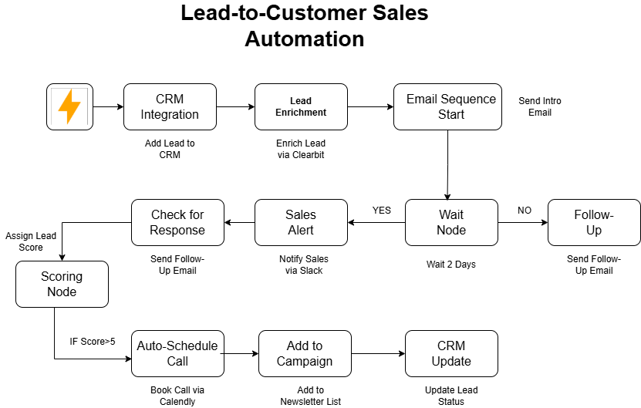

NEXAGENT
OUR SOLUTION
Plug-and-Play Workflows → Build custom automations with zero coding through a drag-and-drop interface.
Prompt-to-Agent → Simply describe your task, and NexAgent will auto-generate the required integrations and workflow.
Agentic AI Core → Autonomous agents that self-orchestrate tasks, optimize resources, and adapt workflows in real time.
PAGE 03

Slide 4
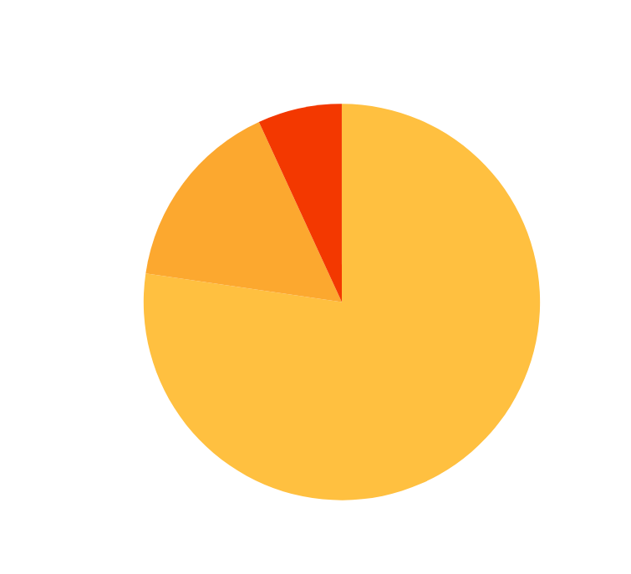
NEXAGENT
MARKET OPPORTUNITY
TAM (Global AI & Automation): $279B in 2024, projected to reach $1.8T by 2030. ~ nextmsc.com
SAM (Emerging Market SMEs): ~$23B opportunity in workflow automation across SMEs in developing economies. ~ Market.us
SOM (Pakistan SME Segment): ~$500M opportunity, based on 5.2M SMEs (40% of GDP, 80% of workforce) with low automation adoption. ~The Express Tribune
PAGE 04

Slide 5

NEXAGENT
BUSINESS MODEL
NexAgent’s business model leverages multiple revenue streams, driving both sustainable growth and scalable expansion.
Subscription Plans
Enterprise Licensing
Marketplace Revenue
Access NexA’s AI workflow builder with tiered plans offering more usage, features, and support. Starter Offer from 15$/Month
Custom NexA deployments with dedicated support, compliance, and integrations for large clients. Pro Offer from 45$/Month
Commissions from third-party workflows, connectors, and AI apps sold via NexA’s marketplace. Custom Offer
PAGE 05

Slide 6
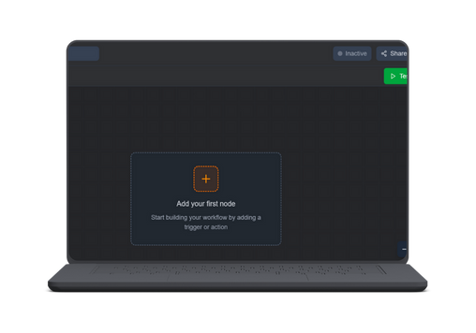
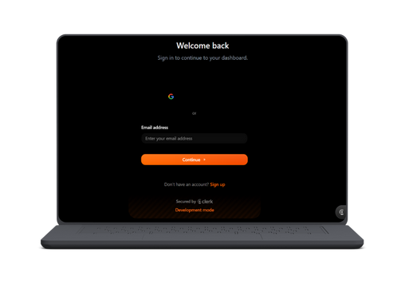
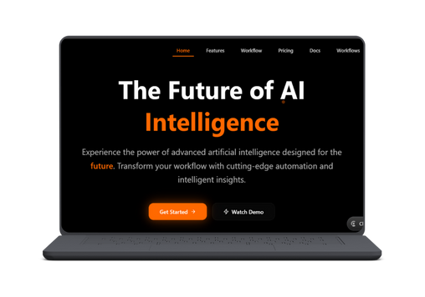
NEXAGENT
PRODUCT OVERVIEW
Seamless AI-Driven Workflow Automation for Business Growth
AI-powered workflow orchestration
No-code drag & drop builder
Prompt-based workflow integrations
PAGE 06

Slide 7

NEXAGENT
TRACTION & GROWTH
Current Status:
MVP under development (drag-and-drop builder + Agentic AI prompt feature)
Future Milestones:
Q2 2026:
MVP Launch
Q3 2026:
Paid subscriptions live (Starter & Pro tiers).
Q1 2027:
2,500+ active users
PAGE 07

Slide 8

NEXAGENT
COMPETITIVE ANALYSIS
Zapier | Low Complexity, Weak AI.
Make.com | Medium Complexity, Week AI
N8N | High Complexity, Weak AI
NexAgent | Low Complexity, Strong AI
PAGE 08

Slide 9
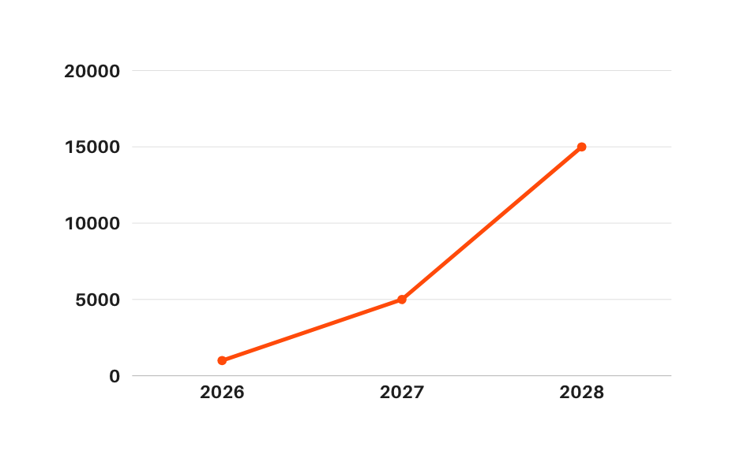
NEXAGENT
FINANCIAL PROJECTIONS
ARR: $ 0.40M
ARR: $ 2.05M
ARR: $ 6.5M
USERS
These projections outline our expected user growth, market expansion, and increasing adoption over time.
YEAR
PAGE 09

Slide 10




NEXAGENT
OUR TEAM
Dr. Humaira Waqas
Faculty Advisor
Maarij Bukhari
AI-Developer
Syed M. Taha
Front-end Developer
Abdullah Yaqoob
Back-end Developer
PAGE 10

Slide 11
NEXAGENT
JOIN US IN BUILDING THE FUTURE OF AUTOMATION
PARTNER WITH US TO SCALE AI-POWERED AUTOMATION FOR SMES.
NEXTAGENT1@GMAIL.COM
HTTPS://NEX-AGENT-AZURE.VERCEL.APP/
@NEXAGENT
PAGE 11

